Slide 1
CONFIDENTIAL
DanDrit Biotech
Developing the World’s First
Colorectal Cancer Vaccine
Investor Presentation 2015

Slide 2
Investment Highlights
Developing the World’s First Colorectal Cancer Vaccine
DanDrit has a technological competitive advantage over other cancer vaccines and provides a unique solution for a major problem
Colorectal cancer has the second largest death rate among cancers
Promising Phase II data in colorectal cancers
DanDrit agreement with myTomorrows (http://www.mytomorrows.com/) provides early access to DanDrit colorectal cancer vaccine to terminally ill patients
We believe that myTomorrows agreement provides an identified path for DanDrit to generate cash flow in 2015

Slide 3
Economic Key Figures
DANDRIT BIOTECH USA, INC. is listed on the NASDAQ stock exchange (ddrt)
During the 3rd and 4thquarter of 2014 the Company’s has made a public offering at a price of $5.00 and today there are 9,533,290 shares of Common Stock of the Company issued and outstanding.
The total market valuation is 47,666,450 USD (with a stock price at 5 USD per share.
Result last quarter – 525,243 USD.
Cach flow last quarter + 6,210,289 USD
Production capacity Q1.2015 – 500 vaccines, production capacity can doubles with 3 month notice. Net income pr. vaccine is 12.000 USD.

Slide 4
Leadership
Experience in management for oncology drug development
  Dr. Eric Leire, CEO and Director
    MD, MBA (HEC-ISA and Northwestern U. Kellogg School of Management)
    4 years: Harvard University, Harvard AIDS Institute, research assistant
    9 years Pharma experience: Pharmacia, Schering-Plough, Pfizer
    15 years experience in Biotech:
      Partner at Biostrategies Group, Boston
      CEO of US venture-backed biotech companies: APT Therapeutics and Paringenix
    5 years experience venture capital as Partner at Biofund Venture
  Robert E. Wolfe, CFO and Director
    Significant CFO experience with listed technology companies
      Advanced Oxygen Technologies, Inc. New York, NY (NASDAQBB:AOXY)
      Iso-Ware A/S, Anton Nielsen Vojens ApS, Crossfield Inc. and Crossfield companies, Drumbeg Holdings LTD, Ludlow Leasing, Inc.

Slide 5
Board of Directors
Niels Erik Nielsen, Chairman
  Partner, Lett Law Firm in Denmark, specialize in M&A, stock exchange regulations and banking.
  Legal adviser to Danish and international companies as well as venture funds in connection with M&A, restructurings and mergers as well as cross-border transactions.
  Chairman of the boards of various listed Danish companies and sits on committees and councils set up by the Danish Government.
Dr. Jacob Rosenberg
  MD, Professor of Surgery at the University of Copenhagen
  Chief surgeon at Herlev Hospital in Copenhagen
Aldo Petersen
  Chief Executive Officer of APE Invest A/S
  Chairman of LiqTech International
  Private investor in wind farms in Germany and France
  Major investor in Greentech, Football Club Copenhagen

Slide 6
  2nd Generation of
  Cancer Vaccines

Slide 7
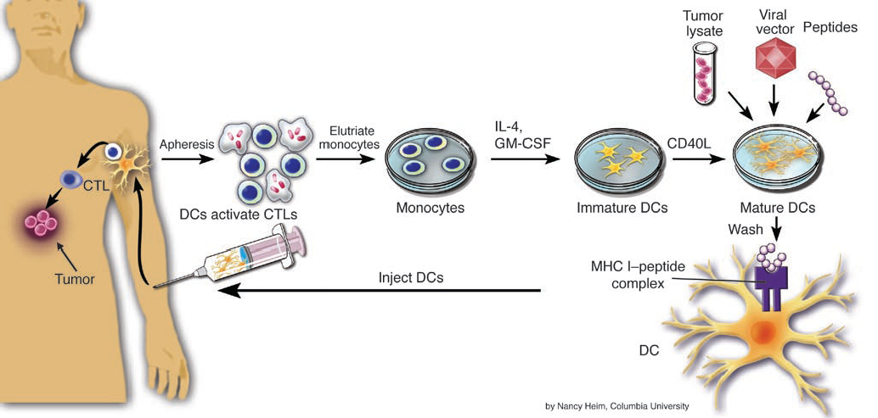
MelCancerVac® (MCV):
Harnessing the Power of the Immune System
1. Obtaining Patients Blood (ca 250mL)
3. Preparation of DC and lysate loading
Patent
WO/2007/065439
2. Purification of monocyte
(DC precursor cells)
Patent
WO/2003/045427
Cytokine
cocktail
Blood
MHC I / MHC II peptide complex
Patent
WO/2009/062515
5. Injection of DC-vaccine back to patient
4. Examination of resulting cells (quality control)
Fast generation of Dendritic cells
Kvistborg P. et al, Cellular Immunology, 2009

Slide 8
  Promising Phase II Data

Slide 9
MCV Clinical Phase IIa
Advanced Colorectal Cancer
[National Cancer Center, Singapore]
n=20
Blood samples taken for vaccine production
2nd blood samples taken for vaccine production
Tumor sample taken
for MAGE antigen expression
BiWeekly CT Monthly CT
Treatment
Off study
Blood samples taken for immunomonitoring

Slide 10
Promising Phase II Data
Advanced Colorectal Cancer
20 patients with advanced colorectal cancer
1/20 patient with partial response (PR)
7/20 patients with stable disease (SD)
Overall Clinical Benefit Rate (CBR) 40%
2 patients still surviving after 40 months
Immune correlation: ELISPOT IFN γ
Data published in: Clinical Cancer Research, December 15, 2009
Approved and on-going compassionate use in Singapore

Slide 11
Colorectal Cancer Trial
Meta-analysis of 32 global cancer vaccine clinical studies in advanced colorectal cancer
CBR in 11.2% of patients
Overall response rate (CR and PR) of 0.9%
Defined clinical benefit rate (CR, PR, SD or mixed response) 17% (12/70) of colorectal cancer patients who received DC vaccines
MCV Phase IIa trial in advanced colorectal cancer
CBR in 40% of patients
Overall response rate 5%
Stable Disease 35%
Clinical and Immunologic Responses to Active Specific Cancer Vaccines in Human Colorectal Cancer
Dirk Nagorsen and Eckhard Thiel
Clin Cancer Res 2006;12:3064-3069

Slide 12
  State-of-the-Art Phase III in Advanced Colorectal Cancer

Slide 13
Favorable Competitive Landscape
GSK / Agenus
Tapimmune
Newlink Genetics
NovaRx
DanDrit
DanDrit
Vaccinogen
Immatics
Bavarian Nordic
Dendreon
Bavarian Nordic
Tapimmune
Agenus
Northwest Bio
Oxford Biomedica
Number of Deaths by Cancer
Galena Biopharma
Antigen Express
Provectus
GlobeImmune
BioSante
Newlink Genetics
Biovest
Biovex
Immunovative
Avax
GSK
PrimaBioMed
Avax
Top Killer Cancers

Slide 14
ACTIVED: Phase III Clinical Trial Advanced CRC
Advanced colorectal cancer patients after surgical resection and chemotherapy. No Evidence of Disease.
Futility Analysis
Surgery
Randomization
FOLFOX
10 VACCINES bi-weekly
5 VACCINES bi-monthly
 |  |  |  |  |  | 1 | 2 | 3 | 4 | 5 | 6 | 7 | 8 | 9 | 10 | 11 | 12 | 13 | 14 | 15 | 16 | 17 | 18
Months
87
174 patients
Disease Free Survival
at 18 months
Blood samples taken for vaccine production (250ml)
 |  |  |  |  |  | 1 | 2 | 3 | 4 | 5 | 6 | 7 | 8 | 9 | 10 | 11 | 12 | 13 | 14 | 15 | 16 | 17 | 18
87
Randomized Seamless Adaptive Phase III
Multicenter Italy with GISCAD
PI: Pr. A. Sobrero
Chair IDMC: Pr. Axel Grothey (Mayo Clinic)
Page 14

Slide 15
  Colorectal Cancer Vaccine: Significant Market Opportunity

Slide 16
CRC Peak Opportunity MCV: US$4.6B
USA: 1.100.000 CRC Prevalence
EU: 2.200.000 CRC Prevalence
Stage IV (20%): 220.000
Stage III (28%): 308.000
Resectable (30%): 66.000
Non resectable (70%): 154.000
Mage A + (50%): 33.000
Mage A + (50%): 77.000
Mage A + (50%): 154.000
Penetration Rate(30%): 9.900
Penetration Rate(15%): 11.550
Penetration Rate(15%): 23.100
If Cost of Therapy US$ 35,000 (Provenge™ $93,000; Zytiga™ $40,000)
US$ 346M
US$ 404M
US$ 808M
US$ 3.116M
US$ 750M
US$ 1.558M

Slide 17
Strategy
Confirm positive data
Phase III advanced NED colorectal cancer patients randomized trial
Set up profitable patient name use program
First in Europe
Followed by MENA with partner Riyadh Pharma
Possible exit through trade sale within 3 years
Short list of potential buyers

Slide 18
  Changing
  Our Value Creation Curve

Slide 19
Patient Name Use Program
Agreement with MyTomorrows
Worldwide online platform providing access to non registered medicines for patients with life threatening or debilitating diseases
Turnkey solution: permits recruitment, logistics, pharmacovigilance, etc
Change the traditional value creation curve
Signiﬁcant revenue: expect to be cash flow generating in 2015
Real life data generation
Ongoing pre-marketing during registration and reimbursement period
Instant successful market launch, without traditional lag phase
Access to new emerging markets

Slide 20

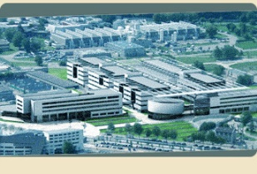
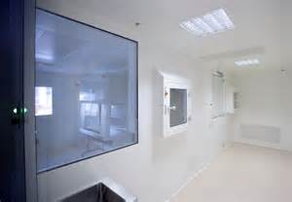
Patient Name Use Program
Step 1:
Denmark
Netherland
France
Turkey
Step 2: + 3 months
Belgium
Italy
Spain
Step 3: + 3 months
Israel
Sweden
Norway
USA and Canada are excluded from MT ‘s deal
Partnership for MENA with Riyadh Pharma
Regional production
Distribution PNUP
Approval with SFDA
MyTomorrows, The Netherlands: PNUP
PXT, France: GMP lysate manufacturing
Cellin Technologies, Estonia: GMP vaccine manufacturing EU
Riyadh Pharma, Saudi Arabia: GMP vaccine manufacturing for MENA

Slide 21
Developing the World’s First Colorectal Cancer Vaccine
Game-changing investment
in a growing market
unaffected by economic conditions

Slide 22
Long Life Patent Estate
Issued patents
  Pharmaceutical composition for introducing an immune response in a human or animal
  Protocol for generating dendritic cells
  Method for generating tolerogenic dendritic cells employing decreased temperature
  Micro RNA’s as markers on the functional state of a dendritic cell
Trademarks
  MelCancerVac™
  Melvaxin ™
  DanDrit ™

Slide 23
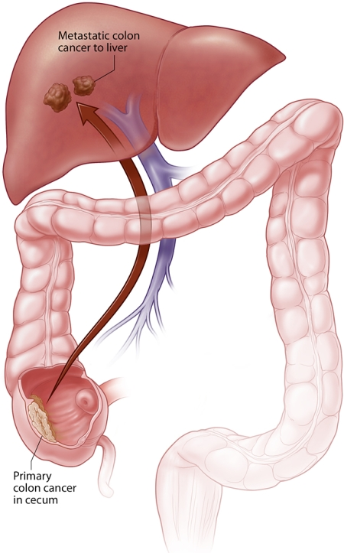
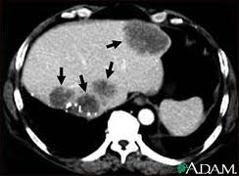
Major Unmet Medical Need

Slide 24
Upcoming Milestones
Patient Name Use Program in Europe
  Q1 2015: First patient receives MCV vaccine
  2015: cash flow positive company
  2015: manufacturing in KSA (MENA region)
Clinical trial
  January 2015: CTA in Italy (through GISCAD)
  April 2015: Fist patient enrolled in ACTIVED
  December 2015: Fully enrolled clinical trial
  December 2017: Interim results. Move to pivotal phase
US / Regulatory
  May 2015: tech transfer to US CMO
  June 2015: IND open in the US
  September 2015: accelerated development pathway negotiated with FDA
  October 2015: on going one site clinical trial in the US
  January 2016: Patient Name Use Program in the US

