Slide 1
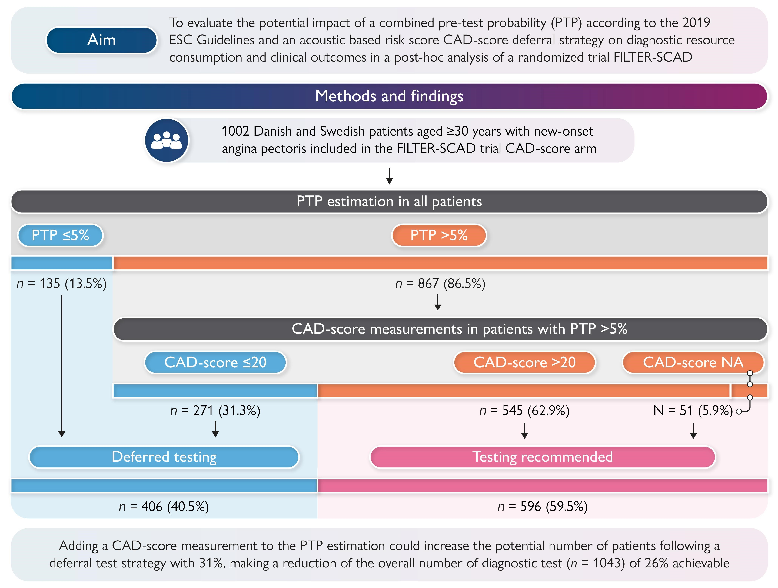

Graphical Abstract
Notes:
Graphical Abstract
Unless provided in the caption above, the following copyright applies to the content of this slide: © The Author(s) 2026. Published by Oxford University Press on behalf of the European Society of Cardiology.This is an Open Access article distributed under the terms of the Creative Commons Attribution-NonCommercial License (https://creativecommons.org/licenses/by-nc/4.0/), which permits non-commercial re-use, distribution, and reproduction in any medium, provided the original work is properly cited. For commercial re-use, please contact reprints@oup.com for reprints and translation rights for reprints. All other permissions can be obtained through our RightsLink service via the Permissions link on the article page on our site—for further information please contact journals.permissions@oup.com.

