Slide 1
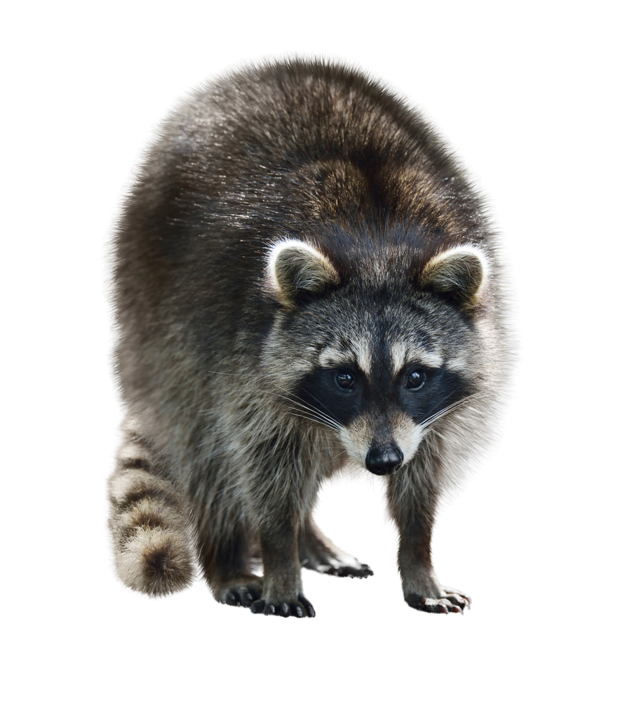
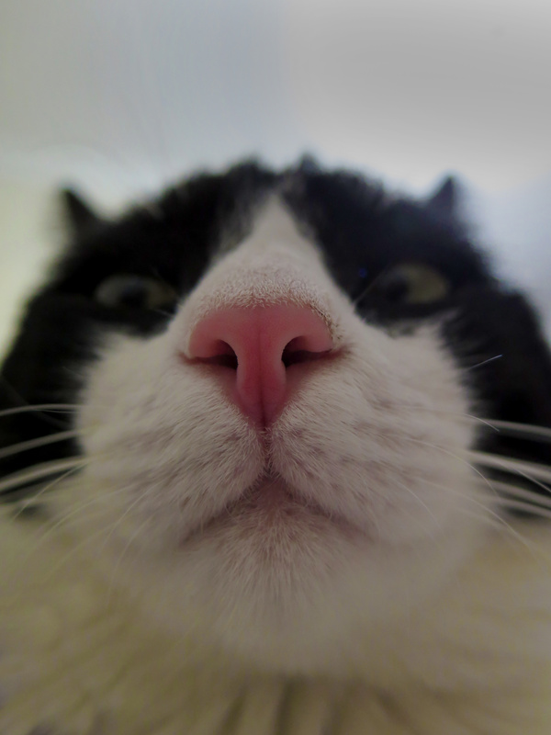

Presents I would like to have
By your lovely wife

Slide 2
This is a presentation of presents I would like to have. You don’t need to buy all of them but if you want to, that’s fine too hehe. Just to remember you, I had great grades and I worked really hard. Maybe I don’t deserve all of them but a lot of them. Let’s begin!

Slide 3
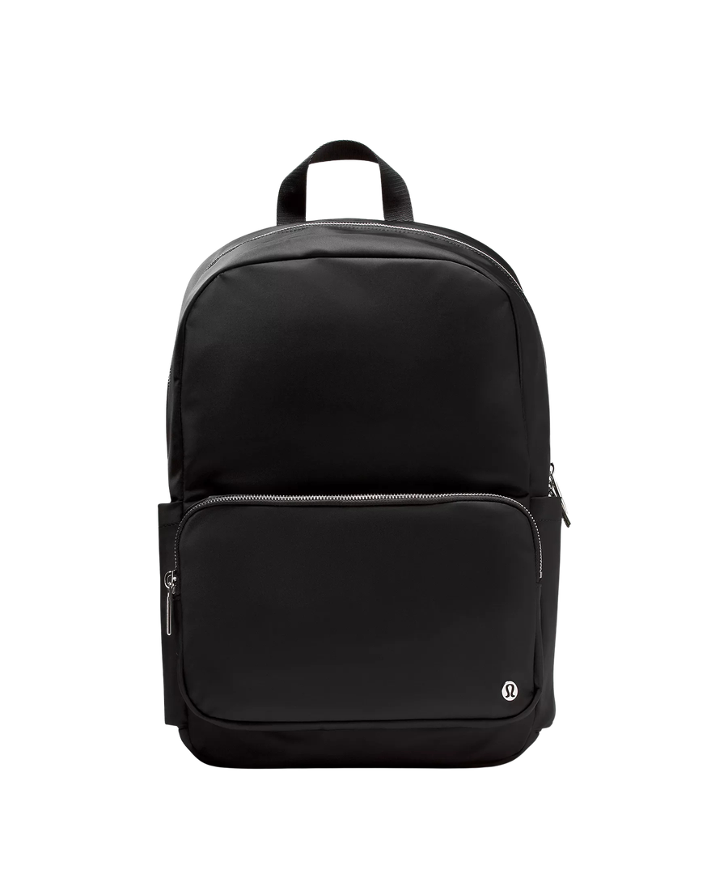
Lululemon everywhere backpack 22L metal hardware
  I really want this backpack
  I need a new backpack
  I don’t have any black backpack

Slide 4
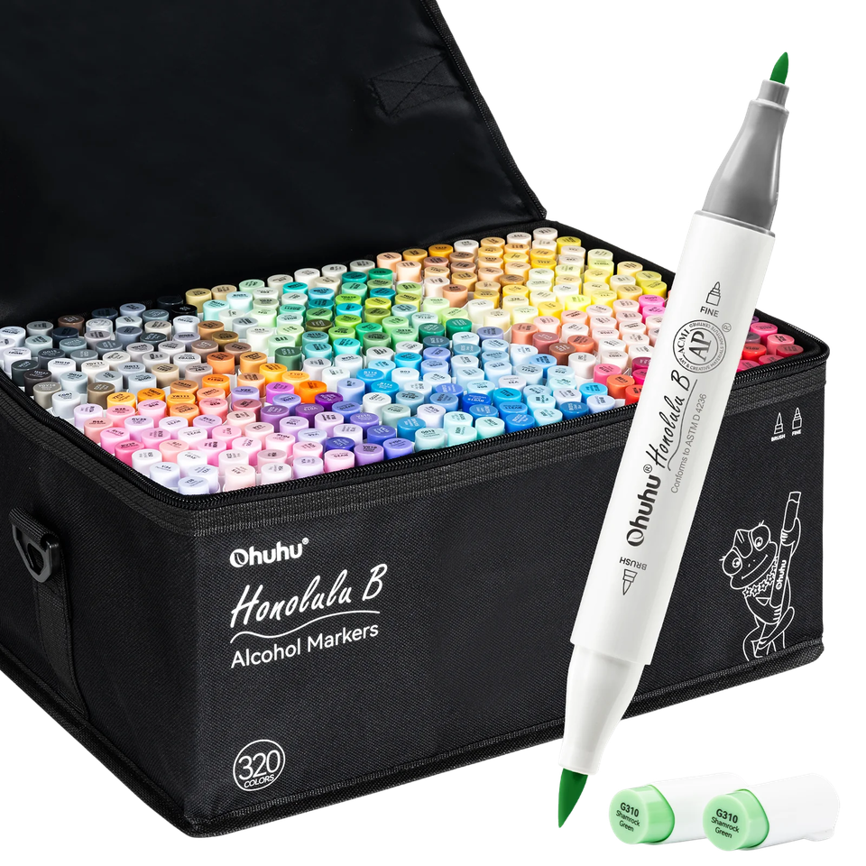
Ohuhu Honolulu 320 colors brush & fine
  I really want these markers
  I need them because I barely have colors
  I really want these markers x2
  I have a lot of coloring books and I need more markers

Slide 5
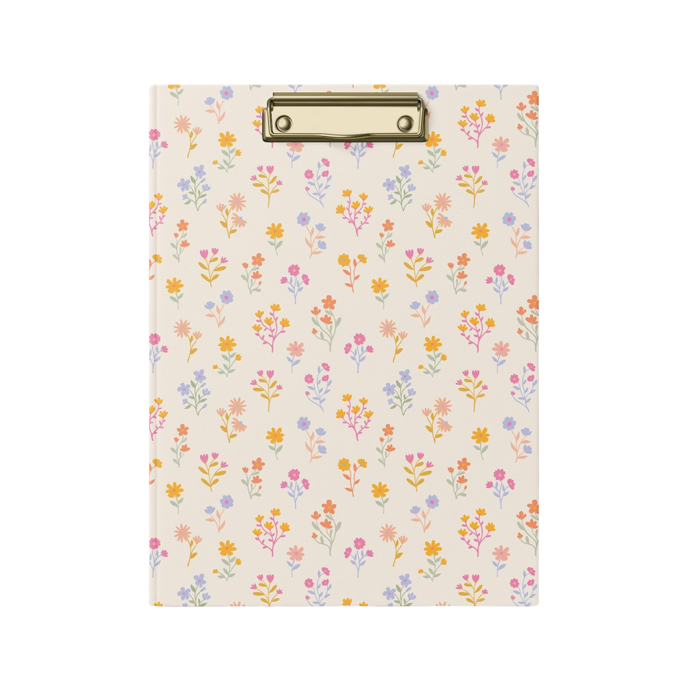
Clip Folio Olivia, Lepetitableauxnoir, Etsy
  I really want this clip folio
  I need one for when I visit future clients
  It’s cute

Slide 6
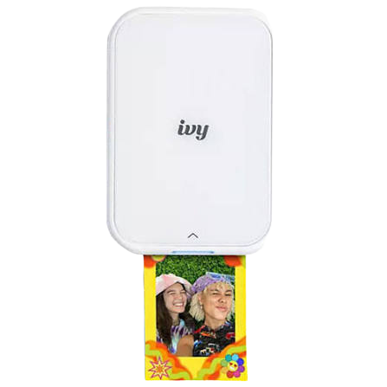
Canon ivy 2
  I’ve wanted this for a long time
  I need it for my hobonichi
  I could print pictures of us

Slide 7
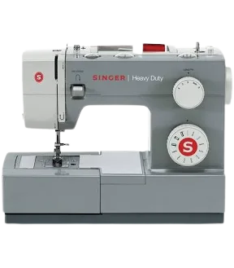
Sewing machine Singer
  I want to learn to sew
  I could make cute clothes
  It will save us money

Slide 8
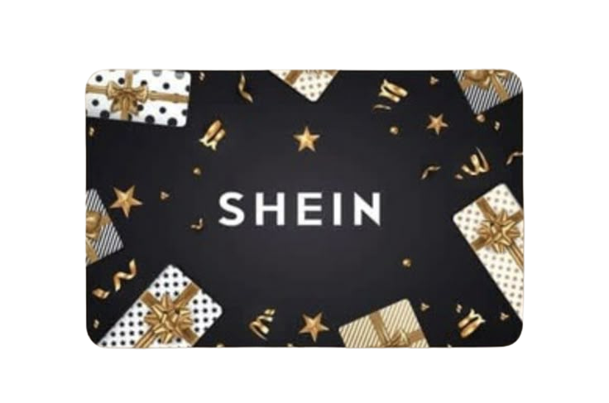
Shein gift card
  I want to buy more stickers, washi tapes, etc
  I need it for my hobonichi
  It would make me happy

Slide 9




A trip to NYC
  I really want to go again
  My heart is asking me to go
  We didn’t see everything we wanted
  I’m in love with NYC

Slide 10
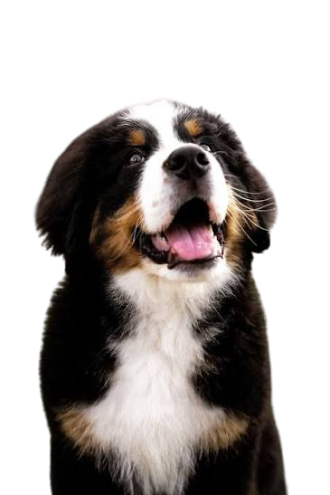
A bernese mountain dog
  They are very cute
  We have a house so we have space
  It would make me very happy
  Alex needs a brother or a sister

Slide 11
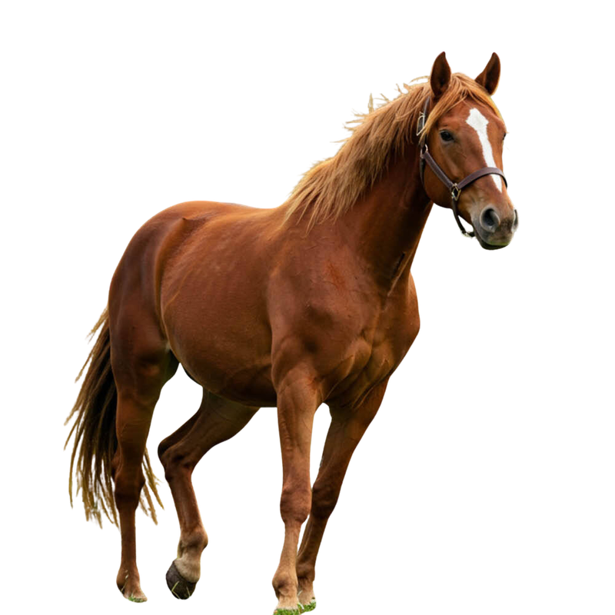
A horse
  It’s my favourite animal
  I love horses
  It would make me very happy
  I deserve one

Slide 12



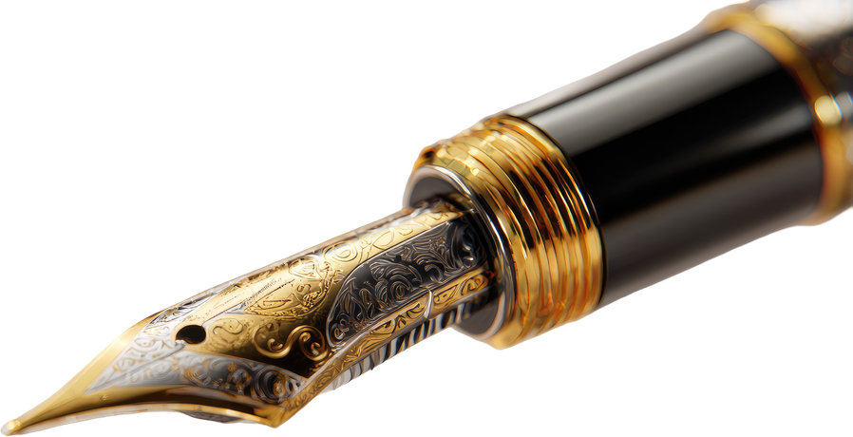
BONUS PRESENTS!!!
  You know I love stationery stuff
  It makes me very happy
  Anything is welcome
  I deserve it

Slide 13
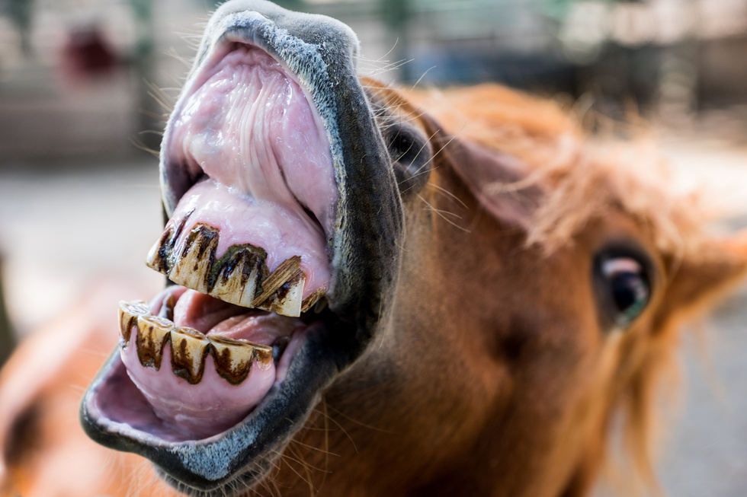
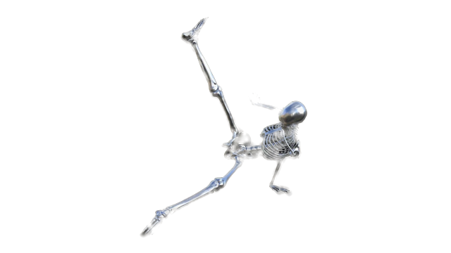
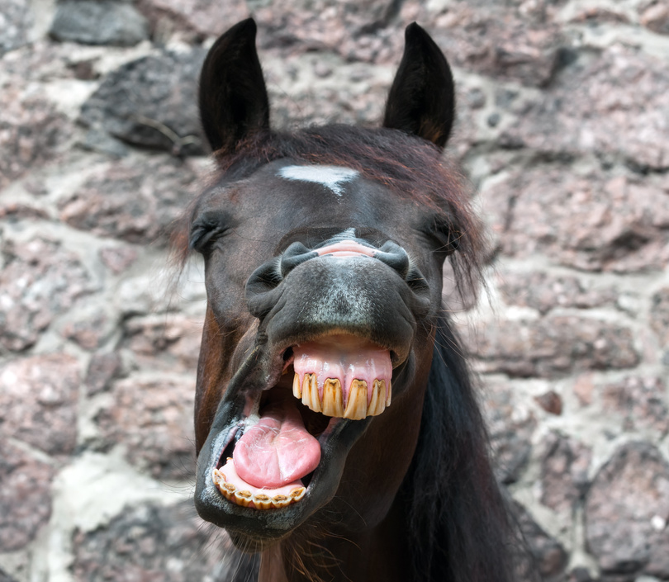
Thank you for watching!

